Slide 1
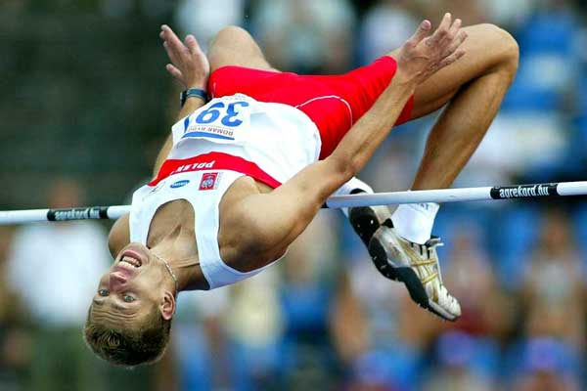
Characteristic of the technical training in elite high jumping
Piotr Bora

Slide 2
Many coaches think that is strictly connection between the level of technique and sport results
Teaching and improving of the technique means that the athlete ought to work on his approach, take-off, rhythm and speed of the particular phases as well as on the technique of the jump

Slide 3
Tab. 1 The structure of the annual training for the elite high jump
Period | Preparatory | Competitions (indoor) | Preparatory | Competitions (outdoor) | Transition
Nº of weeks | 12 | 6 | 12 | 16 | 6

Slide 4
Tab. 2 The training macrocycle structure for high jumper – indoor season
Period | Macrocycle
 | Preparatory |  |  |  |  | Competition
Mesocycles | Introductory | Basic | Special preparation | Technical preparation | Pre- competition
Nº of weeks | 2 | 3 | 4 | 3 | 2 | 6

Slide 5
Tab.3 The training macrocycle structure for high jumper - outdoor season
Period | Macrocycle
 | Preparatory |  |  |  | Competition
Mesocycles | Basic | Special preparation | Technical preparation | Pre- competition
Nº of weeks | 3 | 3 | 3 | 2 | 16

Slide 6
Introductory Mesocyckle
Monday – flexibility + jumping
Tuesday – strength I + el. of high jump technique
Wednesday – flexibility + special running drills
Thursday - -----------
Friday - strength II
Saturday - general endurence
Sunday - -------------

Slide 7
Introductory Mesocyckle
1 . Warm up
2 . Strength I
3. El. of high jump technique
imitation of take-off
every 1 step 4x6 take off leg, 1x6 swing leg
every 3 steps 4x4 take off leg, 1x4 swing leg
4. Cool down

Slide 8
Basic Mesocyckle
Monday – el. of high high technique + jumping
Tuesday – strength I + el. of high high technique
Wednesday – general endurence
Thursday - strength II
Friday - flexibility + jumping
Saturday - speed endurence
Sunday - -------------

Slide 9
Basic Mesocyckle
1 . Warm up
2. Jumping + El. of high jump technique
multibounds LL-RL, LL, RL LLLL-RLRL
Rhythms of take-off
every 1 step 4x6 take off leg, 1x6 swing leg
every 3 steps 4x4 take off leg, 1x4 swing leg
every 5 steps 4x4 take off leg, 1x4 swing leg
3. Cool down

Slide 10
Basic Mesocyckle
1 . Warm up
2 . Strength I
3. El. of high jump technique
Rhythms of take-off
every 1 step 3x6 take off leg, 1x6 swing leg
every 3 steps 3x4 take off leg, 1x4 swing leg
4. Cool down

Slide 11
Special Preparation Mesocyckle
Monday – high jump technique
Tuesday – strength I + el. of high jump technique
Wednesday – flexibility + speed + jumping
Thursday - strength II
Friday – jumping + el. of high jump technique
Saturday - speed endurence
Sunday - -------------

Slide 12
Special Preparation Mesocyckle
1 . Warm up
2. High jump technique
Special acrobatic drills 10-15 minutes
Scissor technique
approach 4 steps 3-4 repetitions
approach 6 steps 3-4 repetitions
Flop technique
approach 4 steps 3-4 repetitions
approach 6 steps 3-4 repetitions
Flop technique
approach 3 steps (take off – swing leg) 6-8 repetitions
3. Cool down

Slide 13
Special Preparation Mesocyckle
1 . Warm up
2 . Strength I
3. El. of high jump technique
Rhythms of take-off
every 1 step 4x6 take off leg, 1x6 swing leg
every 3 steps 4x4 take off leg, 1x4 swing leg
4. Cool down

Slide 14
Special Preparation Mesocyckle
1 . Warm up
2. Jumping + El. of high jump technique
jumping (multi-bounds, hurdle hops)
Special acrobatic drills 10-15 minutes
Rhythms of take-off
every 1 step 3x6 take off leg, 1x6 swing leg
every 3 steps 3x4 take off leg, 1x4 swing leg
3. Cool down

Slide 15
Technical Preparation Mesocyckle
Monday – strength I + el. of high jump technique
Tuesday – high jump technique
Wednesday – flexibility + speed
Thursday - strength II
Friday - high jump technique
Saturday - flexibility + speed + jumping
Sunday - -------------

Slide 16
Technical Preparation Mesocyckle
1 . Warm up
2 . Strength I
3. El. of high jump technique
Rhythms of take-off
every 1 step 3x6 take off leg, 1x6 swing leg
every 3 steps 3x4 take off leg, 1x4 swing leg
4. Cool down

Slide 17
Technical Preparation Mesocyckle
1 . Warm up
2. High jump technique
Special acrobatic drills 10-15 minutes
Scissor technique
approach 4 steps 2-3 repetitions
approach 6 steps 2-3 repetitions
Flop technique
approach 4 steps 4-6repetitions
approach 6 stpes 6-8 repetitions
full approach 3-4 repetitions
3. Cool down

Slide 18
Technical Preparation Mesocyckle
1 . Warm up
2. High jump technique
Special acrobatic drills 10 minutes
Flop technique
full approach 10-12 repetitions
3. Cool down

Slide 19
Pre-Competition Mesocyckle
Monday – strength I
Tuesday – high jump technique
Wednesday – speed + jumping
Thursday - strength II
Friday - ----------
Saturday - competition
Sunday - -------------

Slide 20
Pre-Competition Mesocyckle
1 . Warm up
2. High jump technique
Special acrobatic drills 10 minutes
Flop technique
full approach 8-10 repetitions
3. Cool down

Slide 21
Competion Mesocyckle
Monday – strength I
Tuesday – high jump technique
Wednesday – speed + jumping
Thursday - strength II
Friday - ----------
Saturday - competition
Sunday - -------------

Slide 22
Competion Mesocyckle
1 . Warm up
2. High jump technique
Special acrobatic drills 10 minutes
Flop technique
full approach 6-8 repetitions
3. Cool down

Slide 23
Tab. 4 The training macrocycle structure for high jumper - competition period
Period | Competition
Mesocycles | Competition I | DCP | Competition II
Nº of weeks | 5 | 6 | 5

Slide 24
Direct Competition Preparation
The period of preparation before main competitions and lasts five to seven weeks
Sport training assumptions are based on knowledge, experience and invention of a coach

Slide 25
The typical structure of direct competition preparation in elite high jump is divided into three phases:
Accumulation
Intensification
Transformation

Slide 26
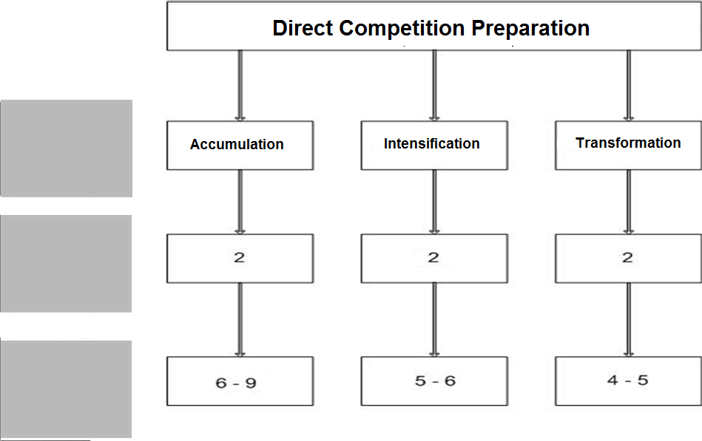
Tab. 5 The typical structure of direct competition preparation in elite high jump
mesocycle
microcycle
training session

Slide 27
Table 6. The structure of direct competition preparation in elite high jump (Accumulation)
MICROCYCLE | MONDAY | TUESDAY | WEDNESDAY | THURSDAY | FRIDAY | SATURDAY | SUNDAY
I ACCUMULATION | Elements of high jump technique | Flexibility + speed | Warm up | shot throwing (medicine ball) | Elements of high jump technique | Flexibility + speed | --------
 | Strength I | Swimming + biological recovery | Jumping | Biological recovery | Strength II | Swimming + biological recovery | --------
II ACCUMULATION | High jump technique | Flexibility + speed | Warm up | shot throwing (medicine ball) | High jump technique | Flexibility + speed | -------
 | Strength I | Biological recovery | Jumping | Biological recovery | Strength II | Biological recovery | --------

Slide 28
Accumulation I
1 . Warm up
2. Elements of high jump technique
Special acrobatic drills 10-15 minutes
Imitation of take-off
every 1 step 3x6 take off leg, 1x6 swing leg
every 3 steps 3x4 take off leg, 1x4 swing leg
3. Cool down

Slide 29
Accumulation II
1 . Warm up
2. High jump technique
Special acrobatic drills 10-15 minutes
Rhythms of take-off
every 1 step 3x6 take off leg, 1x6 swing leg
every 3 steps 3x4 take off leg, 1x4 swing leg
Scissor technique
approach 4 steps 2-3 repetitions
approach 6 steps 2-3 repetitions
Flop technique
approach 4 steps 4-6 repetitions
approach 6 steps 4-6 repetitions
3. Cool down

Slide 30
Table 7. The structure of direct competition preparation in elite high jump (Intensification)
MICROCYCLE | MONDAY | TUESDAY | WEDNESDAY | THURSDAY | FRIDAY | SATURDAY | SUNDAY
III Intensification | Strength I | High jump technique | Flexibility + Speed + Jumping | Strength II | Biological recovery | High jump technique | Biological recovery
IV Intensification | Strength I | High jump technique | Speed + Jumping | Strength II | ----------- | Competition High Jump | Biological recovery

Slide 31
Intensification
1 . Warm up
2. High jump technique
Special acrobatic drills 10 minutes
Rhythms of take-off
every 1 step 3x6 take off leg
every 3 steps 3x4 take off leg
Flop technique
approach 4 steps 3-4 repetitions
approach 6 steps 3-4 repetitions
full approach 6-8 repetitions
3. Cool down

Slide 32
Table 8. The structure of direct competition preparation in elite high jump (Transformation)
Microcycle | Monday | Tuesday | Wednesday | Thursday | Friday | Saturday | Sunday
V TRANSFORMATION | Strength I | High jump technique | Speed + Jumping | Strength II | ------------ | Competition High Jump | -------
VI TRANSFORMATION | Strength I | Speed + elements of high jump technique | Strength II | ------------- | High Jump Qualification | -------------- | High Jump FINAL

Slide 33
Transformation I
1 . Warm up
2. High jump technique
Special acrobatic drills 10 minutes
Rhythms of take-off
every 3 steps 3x3 take off leg
Flop technique
approach 6 steps 3-4 repetitions
full approach 6-8 repetitions
3. Cool down

Slide 34
Transformation II
1 . Warm up
2. Speed
3. Elements of high jump technique
Special acrobatic drills 10-15 minutes
Rhythms of take-off
every 3 steps 3x3 take off leg (on the curve)
3. Cool down

Slide 35
Tab. 9 The training macrocycle structure for high jumper
- transition period
Period | Transition
Mesocycles | Active Rest I | Active Rest II
Nº of weeks | 3 | 3

Slide 36
Active Rest I Mesocyckle
Monday – warm up + sport games
Tuesday – -----------------------
Wednesday – swimming + bilogical recovery
Thursday - ----------------
Friday - jogging + flexibility
Saturday - ----------------
Sunday - -------------

Slide 37
Active Rest II Mesocyckle
Monday – sport games + general strength
Tuesday – -----------------------
Wednesday – swimming + bilogical recovery
Thursday - ----------------
Friday - jogging + flexibility
Saturday - ----------------
Sunday - -------------

Slide 38
Thank you

