Slide 1
The annual running training
for long and triple jump
Piotr Bora

Slide 2
Running Training
Endurance
Speed

Slide 3
The annual macrocycle is divided into three periods:
preparatory
competition
transition

Slide 4
Tab. 1 The structure of the annual training for
long and triple
Period | Preparatory | Competition (indoor) | Preparatory | Competition (outdoor) | Transition
Nº of weeks | 12 | 6 | 12 | 16 | 6

Slide 5
Preparatory Period
This is the most important and also most difficult part in the all-year training cycle
The main task is to suitably prepare an athlete for a long and intense competition period

Slide 6
The typical preparatory period consists of
five mesocycles:
introductory
basic
special preparation
technical preparation
pre-competiton

Slide 7
Tab.2 The training macrocycle structure for long and triple jump – preparatory period
Preparatory Period
Mesocycles | Introductory | Basic | Special Preparation | Technical Preparation | Pre- competition
Number of weeks | 2 | 3 | 4 | 3 | 2

Slide 8
Introductory Mesocyckle
One running training session only (general endurance) during a week
The development of endurance takes place outdoors such as in the stadium, grass or forest

Slide 9
Introductory Mesocyckle
The main parts of the workouts consist of:
jogging
stretching
special running drills
There are no speed drills in this mesocycle

Slide 10
Introductory Mesocyckle
Monday – flexibility + jumping
Tuesday – strength I
Wednesday – flexibility + el. of long/triple jump technique
Thursday – ---------
Friday - strength II
Saturday - general endurence
Sunday - -------------

Slide 11
Introductory Mesocyckle
Jogging 2 km
2. Stretching 15 min
3. Special running drills:
A Skips 5x30m
B Skips 5x30m
C Skips 5x30m
4. Jogging 2 km
5. Stretching 20 min

Slide 12
Basic Mesocyckle
Two endurance running training sessions per week
The development of endurance consists of two parts (general endurance and speed endurance)
It should take place outdoors such as in the stadium, grass or forest

Slide 13
Basic Mesocyckle
The main part of the workouts consists of:
jogging
stretching
special running drills (skips)
runs (150 m-200 m)
There are no speed drills in this mesocycle

Slide 14
Basic Mesocyckle
Monday – jumping + el. of long/triple jump technique
Tuesday – strength I
Wednesday – general endurence
Thursday - strength II
Friday - flexibility + jumping
Saturday - speed endurence
Sunday - -------------

Slide 15
Basic Mesocyckle
1. Jogging 3 km
2. Stretching 15 min
3. Special running drills
A Skips 5x30 m
Run 150m
B Skips 5x30m
Run 150m
C Skips 5x30m
Run 150m
4. Jogging 2km
5. Stretching 15min

Slide 16
Basic Mesocyckle
1. Warm up
2. Speed Endurance > recovery 6 min
3x200m, 2x150m
3. Cool-down

Slide 17
Special Preparation Mesocyckle
Two running training sessions: 1x endurance and 1x speed per microcycle
The development of endurance consists of one training session - speed endurance. It should take place at the stadium on grass or on the track
The main part of the workouts includes runs:
120-150 m

Slide 18
Special Preparation Mesocyckle
Speed training occurs once a week and there are some flexibility drills before speed training also
The typical workouts consist of:
accelerations
ins-and-outs runs

Slide 19
Special Preparation Mesocyckle
Monday – long/triple jump technique
Tuesday – strength I
Wednesday – flexibility + speed
Thursday - strength II
Friday - el. of long/triple jump technique + jumping
Saturday - speed endurence
Sunday - -------------

Slide 20
Special Preparation Mesocyckle
1. Warm-up
2. Flexibility
hurdles drills (walking every three steps)
>6x6, 76.2-84cm height
3. Speed >recovery 5-6 min
accelerations 3-4x30m
ins-and-outs runs 3-4x60m
(15m slow +15 m fast + 15m slow + 15m fast)
4. Cool-down

Slide 21
Special Preparation Mesocyckle
1. Warm up
2. Speed endurance >recovery 6 min
3x150m, 2x120m
3. Cool-down

Slide 22
Technical Preparation Mesocyckle
There are two running (speed) training sessions
The development of speed training should take place on the track
There are also some flexibility drills before speed training
The typical workouts include:
speed runs 40-60 m
full approach for the long or triple jump

Slide 23
Technical Preparation Mesocyckle
The running distances to develop speed don’t exceed 60m and are performed relaxed with a gradual increased intensity and without timing
There is no endurance training in this mesocycle

Slide 24
Technical Preparation Mesocyckle
Monday – strength I
Tuesday – long/triple jump technique
Wednesday – flexibility + speed
Thursday - strength II
Friday - long/triple jump technique
Saturday - flexibility + speed
Sunday - -------------

Slide 25
Technical Preparation Mesocyckle
1. Warm-up
2. Flexibility
hurdles drills (walking every three steps)
6x6, 76.2-84 cm height
3. Speed >recovery 6- 8 min
4-6 x 60 m
4. Cool-down

Slide 26
Technical Preparation Mesocyckle
1. Warm-up
2. Flexibility
hurdles drills (walking every one step)
6x6, 76.2-84cm height
3. Speed >recovery 8 min
3-4x40m
full approach and take-off 2-3x (long jump)
full approach and first take-off 2-3x (triple jump)
4. Cool-down

Slide 27
Pre-competion Mesocyckle
The running training workouts are changed with only one speed session
The main part of the workouts include:
40 m runs
full approach for long and triple jump
There are no endurance drills in this mesocycle

Slide 28
Pre-Competition Mesocyckle
Monday – strength I
Tuesday – long/triple jump technique
Wednesday – flexibility + speed
Thursday - strength II
Friday - ----------
Saturday - competition
Sunday - -------------

Slide 29
Pre-Competition Mesocyckle
1. Warm-up
2. Flexibility
hurdles drills (walking every one step)
6x6, 76.2-84cm height
3. Speed >recovery 8 min
3-4x40m
full approach and take-off 2-3x (long jump)
full approach and first take-off 2-3x (triple jump)
4. Cool-down

Slide 30
Competion Period
The most important aim of the Competition Period is to create such conditions that the athlete can achieve their best results
The training process should be very specialised and include preparation for the next competitions
The length of breaks between it depends on the physical and mental preparation and a calendar of events

Slide 31
Tab. 3 The training macrocycle structure for long and triple jump - competition period
Period | Competition
Mesocycles | Competition I | DCP | Competition II
Nº of weeks | 5 | 6 | 5

Slide 32
Competion Mesocyckle
The running training consist of one speed session
The main part of the workouts include:
40 m runs
full approach for long or triple jump
There are no endurance drills in this mesocycle

Slide 33
Competion Mesocyckle
Monday – strength I
Tuesday – long/triple jump technique
Wednesday – flexibility + speed
Thursday - strength II
Friday - ----------
Saturday - competition
Sunday - -------------

Slide 34
Competion Mesocyckle
1. Warm-up
2. Flexibility
hurdles drills (walking every one step)
6x6, 76.2-84cm height
3. Speed >recovery 8min
2-3x40m
full approach and take-off 2-3x (long jump)
full approach and first take-off 2-3x (triple jump)
4. Cool-down

Slide 35
Tab. 4 The training structure (DCP) for long and triple jump
Period | Direct Competition Preparation
Mesocycles | Accumulation | Intensification | Transformation
Nº of weeks | 2 | 2 | 2

Slide 36
Direct Competition Preparation Accumulation
Monday – long/triple jump technique
Tuesday – strength I
Wednesday – flexibility + speed
Thursday - strength II
Friday - el. of long/triple jump technique + jumping
Saturday - flexibility + speed
Sunday - -------------

Slide 37
Direct Competition Preparation Accumulation
1. Warm-up
2. Flexibility
hurdles drills (walking every one step)
>6x6, 76.2-84 cm height
3. Speed >recovery 6-8 min
accelerations 2-3 x 30m
ins-and-outs runs 3-4 x 60m
(15m slow +15 m fast + 15m slow + 15m fast)
4. Cool-down

Slide 38
Direct Competition Preparation Accumulation
1. Warm up
2. Flexibility
hurdles drills (walking every three steps)
>6x6, 76.2-84 cm height
3. Speed >recovery 6-8 min
accelerations 2-3 x 30m
6x40 m
4. Cool-down

Slide 39
Direct Competition Preparation Intensification
Monday – strength I
Tuesday – long/triple jump technique
Wednesday – flexibility + speed
Thursday - strength II
Friday - long/triple jump technique
Saturday - flexibility + speed
Sunday - -------------

Slide 40
Direct Competition Preparation Intensification
1. Warm-up
2. Flexibility
hurdles drills (walking every three steps)
6x6, 76.2-84 cm height
3. Speed >recovery 6- 8 min
4-6 x 60 m
4. Cool-down

Slide 41
Direct Competition Preparation Intensification
1. Warm-up
2. Flexibility
hurdles drills (walking every one step)
6x6, 76.2-84cm height
3. Speed >recovery 8 min
3-4x40m
full approach and take-off 2-3x (long jump)
full approach and first take-off 2-3x (triple jump)
4. Cool-down

Slide 42
Direct Competition Preparation Transformation
Monday – strength I
Tuesday – long/triple jump technique
Wednesday – flexibility + speed
Thursday - strength II
Friday - ----------
Saturday - competition
Sunday - -------------

Slide 43
Direct Competition Preparation Transformation
1. Warm-up
2. Flexibility
hurdles drills (walking every one step)
6x6, 76.2-84cm height
3. Speed >recovery 8 min
2-3 x 40m
full approach and take-off 2-3x (long jump)
full approach and first take-off 2-3x (triple jump)
4. Cool-down

Slide 44
Transition Period
The Transition Period is a consequence of the two previous periods of training
This time is often treated lightly by many athletes and coaches and this is a big mistake. Athletes tend to rest in a passive (this does not apply in cases of treatment for injury)
The period is not indicated for passive relaxation due to the need to start the next training period with a higher sport level

Slide 45
Tab. 5 The training macrocycle structure for long and triple jump - transition period
Period | Transition
Mesocycles | Active Rest I | Active Rest II
Nº of weeks | 3 | 3

Slide 46
Transition Mesocyckle
There should be one running session (general endurance) only and the development of this takes place on grass in the stadium or outside in the forest
The main part of the workout consists of:
jogging
special running drills
It should be noted that are no speed drills in this period

Slide 47
Active Rest I Mesocyckle
Monday – flexibility + sport games
Tuesday – ---------------------
Wednesday – swimming + bilogical recovery
Thursday – --------------------
Friday - general endurance
Saturday - --------------------
Sunday - -------------

Slide 48
Active Rest I Mesocyckle
1. Jogging 2-3 km
2. Stretching 20 min
3. Jogging 2 km
4. Stretching 10 min

Slide 49
Active Rest II Mesocyckle
Monday – flexibility + general strength
Tuesday – ---------------------
Wednesday – flexibility + sport games
Thursday – --------------------
Friday - general endurance
Saturday - --------------------
Sunday - -------------

Slide 50
Active Rest II Mesocyckle
1. Jogging 2 km
2. Stretching 15 min
3. Special running drills:
¼ A Skips 3x30m
½ A Skips 3x30m
A Skips 3x30m
4. Jogging 2 km
5. Stretching 20 min

Slide 51
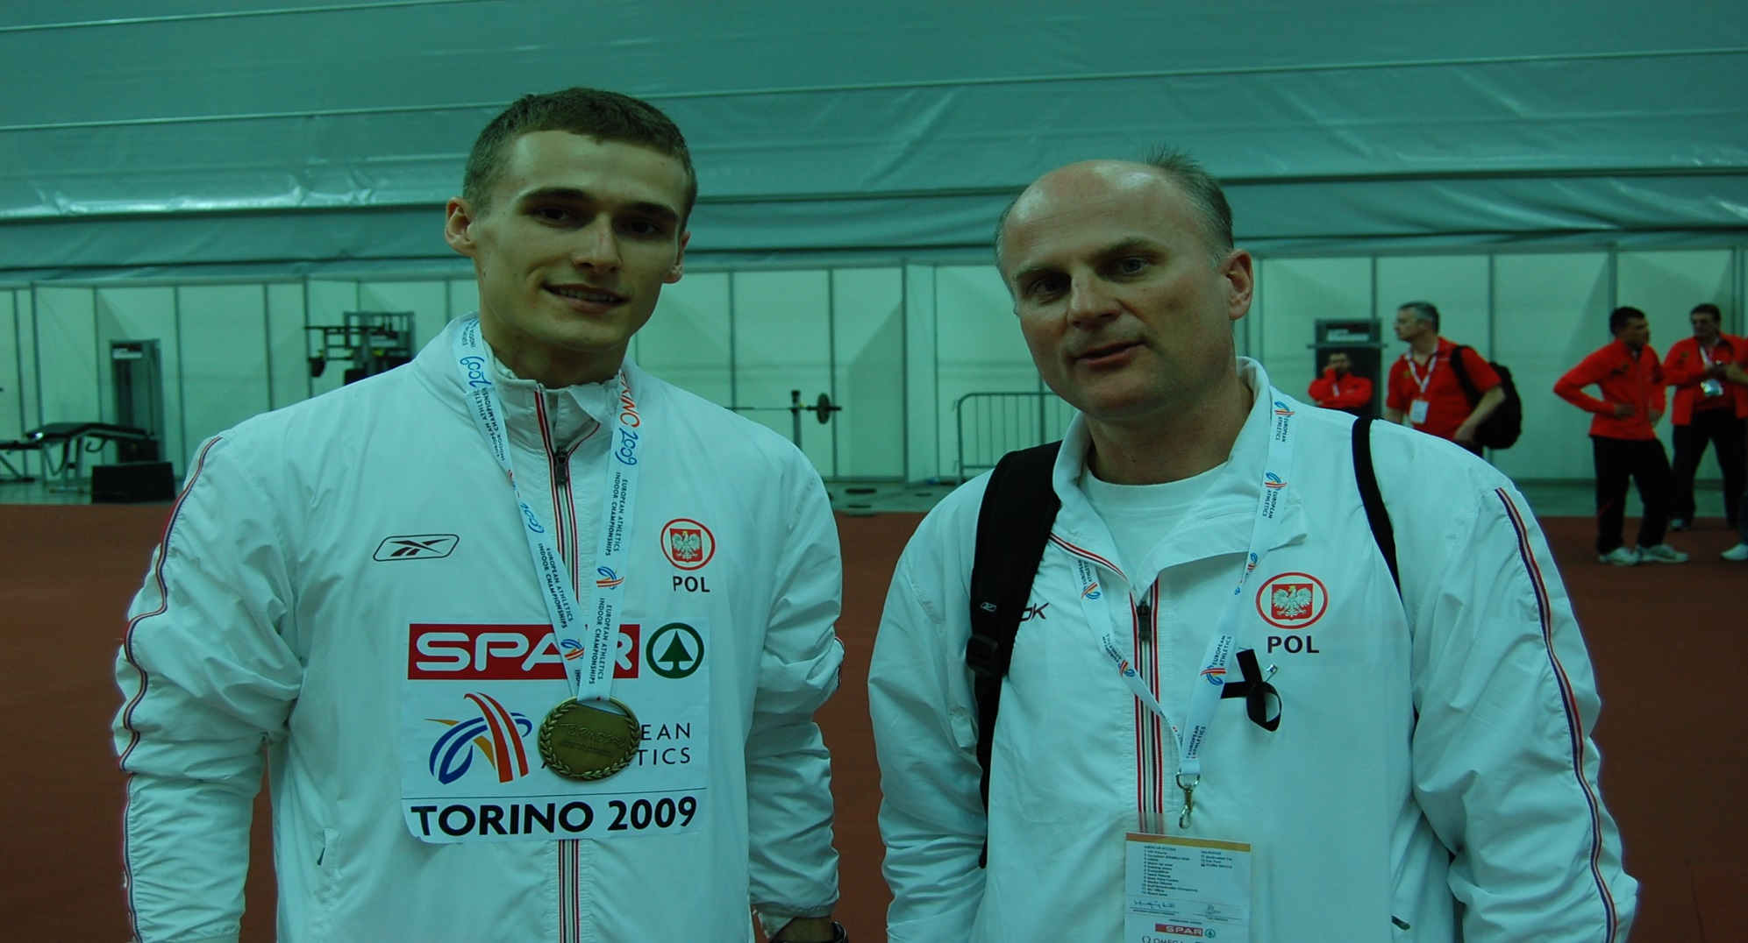
Thank You

