Slide 1
Direct Competition Preparation
in junior triple jump
Piotr Bora

Slide 2
Tab. 1 The training macrocycle structure for young triple jumpers
- competition period
Period | Competition
Mesocycles | Competition I | DCP | Competition II
Nº of weeks | 5-7 | 6 | 5-6

Slide 3
Direct Competition Preparation
The period of preparation before main competitions and lasts five to seven weeks
Sport training assumptions are based on knowledge, experience and invention of a coach

Slide 4
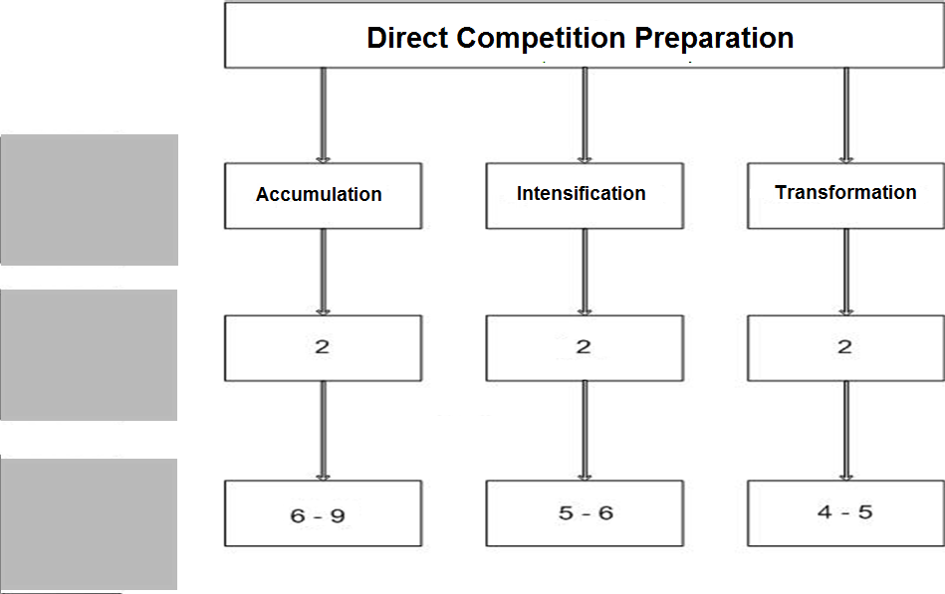
Tab. 2 The typical structure of direct competition preparation in junior triple jump
mesocycle
microcycle
training session

Slide 5
Tab 3. The structure of direct competition preparation in junior triple jump (Accumulation)
MICROCYCLE | MONDAY | TUESDAY | WEDNESDAY | THURSDAY | FRIDAY | SATURDAY | SUNDAY
I ACCUMULATION | TJ technique I | General warm up | Flexibility I + speed | General warm up | TJ technique II | Flexibility II + Speed Endurance | --------
 | Strength I |  | Shot throws (medicine balls) |  | Strength II |  | --------
II ACCUMULATION | TJ technique I | General warm up | Flexibility I + speed | General warm up | TJ technique II | Flexibility II + Speed Endurance | -------
 | Strength I |  | Shot throws (medicine balls) |  | Strength II |  | --------

Slide 6
Direct Competition Preparation Accumulation
Typical workouts for a young triple jumper in this phase consist of the following:

Slide 7
Accumulation STRENGTH I
Half-squat
Quarter-squat
Calf-rise
Step-up
Both legs jumps
Abdominal muscles
Back muscles
series: 4-6
repetitions: 6-10

Slide 8
Accumulation STRENGTH II
Bench press
Snatch
Ankle hops
Abdominal muscles
Back muscles
Adductor muscles of thigh
Hamstring muscles
series: 4-6
repetitions: 5-10

Slide 9
Accumulation FLEXIBILITY I
Hurdle Drills (walking > 1 step)
Lead leg
Trail leg
Middle
series: 6
repetitions: 6

Slide 10
Accumulation FLEXIBILITY II
Hurdle Drills (walking > 3 steps)
Lead leg
Trail leg
Middle
series: 6
repetitions: 6

Slide 11
Accumulation SPEED
A skips + acceleration
Acceleration
Flying or standing sprints
series: 3
distance: 20 – 30 m
recovery: 5-6’

Slide 12
Accumulation SPEED ENDURANCE
standing sprints
series: 5
distance: 120 – 150 m
recovery: 6’

Slide 13
Accumulation TECHNIQUE I
multijumps (LL-RL) -approach 6-8 steps
bounding LL - approach 6-8 steps
bounding RL - approach 6-8 steps
bounding LLLLRL (or RLRLLL) - approach 6-8 steps
long jump from the swing leg take off -approach 6-8 steps
series: 3-4
repetetions: 5-10

Slide 14
Accumulation TECHNIQUE II
„warm up”
„Step” + „Jump” - approach 8-10 steps
standing 5 jumps (LL-RL)
triple jump (short approach - 10 steps)
series: 3 - 4

Slide 15
Accumulation Shot throws
Throws from different positions
series: 6-8
repetitions : 10

Slide 16
Tab. 4. The structure of direct competition preparation in junior triple jump (Intensification)
MICROCYCLE | MONDAY | TUESDAY | WEDNESDAY | THURSDAY | FRIDAY | SATURDAY | SUNDAY
III Intensification | Strength I | TJ technique I | Flexibility + Speed | Strength II | ---------- | TJ technique II | ---------
IV Intensification | Strength I | TJ technique II | Flexibility + Speed | Strength II | ----------- | Competition Triple Jump | ----------

Slide 17
Direct Competition Preparation Intensification
Typical workouts for a young triple jumper in this phase consist of the following:

Slide 18
Intensification STRENGTH I
Half - squat
Quarter-squat
Both legs jumps
Abdominal muscles
Back muscles
series: 2-6
repetitions: 4-10

Slide 19
Intensification STRENGTH II
Ankle hops
Abdominal muscles
Back muscles
Shot throws
series: 3-6
repetitions: 6-10

Slide 20
Intensification TECHNIQUE I
„warm up”
5-jumps (LL-RL) - approach 6-8 steps
long jump (swing leg take off) approach 6-8 steps
triple jump - approach -12 steps
Series: 3 – 6

Slide 21
Intensification TECHNIQUE II
„warm up”
standing 5 jumps (LL-RL)
triple jump (short approach -12 steps)
control approach + „Hop”
series: 3 - 4

Slide 22
Intensification FLEXIBILITY
Hurdle Drills (walking > 1 step)
Lead leg
Trail leg
Middle
series: 6
repetitions: 6

Slide 23
Intensification SPEED
standing sprints
control approach + „Hop”
series: 4
distance: 40 m
recovery: 6-8’

Slide 24
Tab. 5 The structure of direct competition preparation in junior triple jump (Transformation)
Microcycle | MONDAY | TUESDAY | WEDNESDAY | THURSDAY | FRIDAY | SATURDAY | SUNDAY
V TRANSFORMATION | Strength I | TJ technique | Flexibility + Speed | Strength II | ------------ | Competition Triple Jump | -------
VI TRANSFORMATION | Strength I | Flexibility + Speed | Strength II | ------------- | Triple Jump Qualification | -------------- | Triple Jump FINAL

Slide 25
Direct Competition Preparation Transformation
Typical workouts for a young triple jumper in this phase consist of the following:

Slide 26
Transformation STRENGTH I
Quarter-squat
Both legs jumps
Abdominal muscles
Back muscles
series: 3-6
repetitions: 5-10

Slide 27
Transformation STRENGTH II
Ankle hops
Abdominal muscles
Back muscles
series: 3-6
repetitions: 6-10

Slide 28
Transformation TECHNIQUE
„warm up”
standing 5 jumps (LL-RL)
triple jump (short approach -12 steps)
control approach + „Hop”
series: 3 - 4

Slide 29
Transformation FLEXIBILITY
Hurdle Drills (walking > 1 step)
Lead leg
Trail leg
Middle
series: 6
repetitions: 6

Slide 30
Transformation SPEED
standing sprints
control approach + „Hop”
series: 3
distance: 40 m
recovery: 6-8’

Slide 31
Thank you
piotrbora@interia.pl
+48 609 099 959

