Slide 1
Tomasz Lewandowski
Oslo, 8.11.2015
Basic
movement and technique
for distance runners

Slide 2
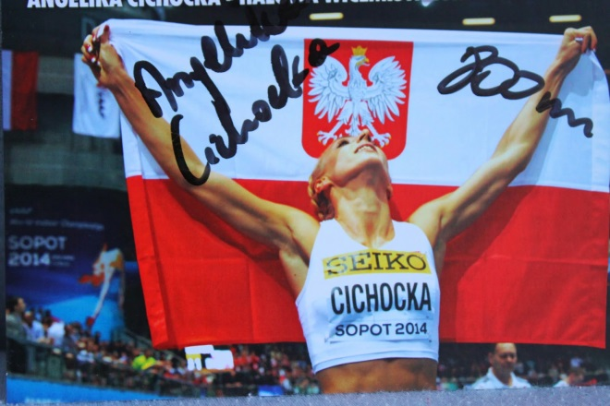
What affects on high performance ?

Slide 3
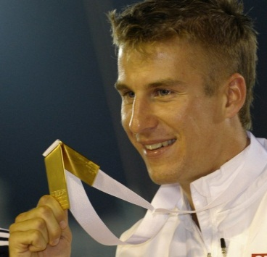
TRAINING
Coaching,
relationship
Diet
LIFESTYLE
Prevention
Regeneration wellness
Motivation,
mental
preparation
Personality
Pressure
Startegy
and tactics
PROPOTIONS ?

Slide 4
What is the most important?
Good workout – bad regeneration
Good motivation – bad brekfast
Good training, motivation, brekfast –
to much *crazy* overhours, lifestyle
Everything is perfect – destructive pressure
Even the smallest detail can ruin years of preparation, destory the (only?) chance.
Everything is important!
Lets go to the training...

Slide 5
TRANING
What do you mean by training ?

Slide 6
TRAINING
Running (endurance, streghtening, speed, coordination)
Functional/physical training (agility, mobility, flexibility, core, pliometrics, power)
Mental training
Tactical training
TECHNIQUE !!

Slide 7
Who is the best?
The guy who choses best tactic?
The strongest physicly or mentaly guy?
The most endure guy (less fatique)?
The guy with best 100m time?
The guy who run exact distance?
The guy who is running high Frequency or long strides?
Negative split, flat race?
It is all about time on the finish line!

Slide 8
SO WHAT IS THE PLAN?
WE USE SHORTCUTS! forgetting about additional trainings (takes time)
Increase speed
Extand workout
Butone day.... Very soon....
We hit the wall.
So we train even harder, often, we go to the power. And that is the end of te story/ athlete.

Slide 9
FRUITS-Benefits
You collect what you sow.
This poor approche produce:
Inuries
Limitations
Lock some doors (training possibilities)
Lock progress, development and growth
Take away a chance to change an event.

Slide 10
GOOD PREPARATION?
https://www.youtube.com/watch?v=iDicTJwqhl4 5sek steeplechase
https://www.youtube.com/watch?v=I-ZfTcDJ84o
Semifinal WCh Berlin 2009
http://www.youtube.com/watch?v=gSG-41fQxFs
Ready for seourious running?
http://www.youtube.com/watch?v=pd_qsTFo5iY&feature=related
https://www.youtube.com/watch?v=IcQ6VQtGKZw

Slide 11
Statistics
How many talets and how many medals?
400m
High level in youth events, because of the wide range of sports or early specialisation (fe. Ski)?
Do we want to kill talents or distroy growing kids?
If yes, we have to care about other things, besides running.

Slide 12
Stronger body = proper posture and running technique = efficiancy = saveing a time = you are faster
Stronger body = injury free = more loads = more self confidence = better performance
THE TIME ON THE FINISH LINE!

Slide 13
What workout improve technique?
All workouts where body needs to handle itself, brain has to have control under muscles, body needs to be rhythmical, coordinated, muscles flexible, hips open and active, joints strong and tendons ready.
Stay focus on:
coordination,
mobility,
agility,
flexibility,
stretching,
strengthening,
dynamic,
mental preparation.

Slide 14
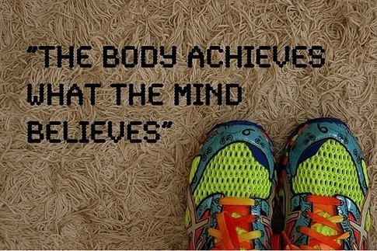
What workout improve technique?
mental preparation

Slide 15
Tools
medicine balls,
rehabilitation balls (the big one),
elastic bands, trx
gymnastic equipment
hurdles,
bars,
mats,
skips, jumps,
pliometrics,
circuit running,
team games,
and all equipment we will find around even rocks, walls, wood, sand, hills.
alternative workout (fitness, aerobic, Pilates, joga, cross fit)

Slide 16
When, how often, how long?

Slide 17
How to process to running?
If you are strong enough your body gets right posture. Now it is a time to transform this stregth to running.
If running technique is stable, stronger, using forces according to physics, then style is efficient.
Better economy means cutting the time which means better performance (you are faster!!).
How to do that?

Slide 18
Diagnose
FOOT (active, possitive stiffness)

Slide 19
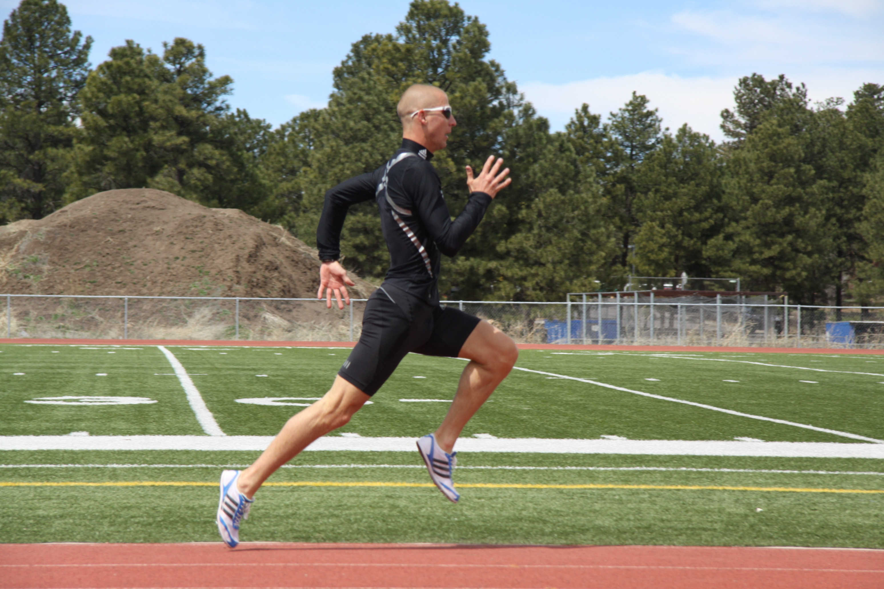
THE KNEE and HIP

Slide 20
Benefits
Foot (ground contact time)
Flexibility 6cm – 16cm /two months/
No injuries
Better economy (saving the energy)
Much more stronger/dynamic (reaction time, changing the rytm/pace)
Universal skills
Atractive workouts (good motivation, not bored)

Slide 22
FUTURE IS BRIGHT ?
Based on rich experience, due to science and club principles I created unique program to support our athletes and use sport as a preparation to adult life and high performance. Call it STEP BY STEP system.
We already know that is the only way to develop kids as athletes where the biggest value is their helth. Behind us there are many autorities, sciencists, parents and teachers.
Sport performance will come from it, not because we skipped it to cut a time (to reach HP quicker).
Until that time players have great fun, movment challanges, team building games, education, they blossom!
We save kids! With us they are safe and happy!

Slide 23
Key points
If you make your body stronger you can save a time and healthy!!
THERE IS NO SHORTCUT TO THE TOP, make it step by step
RUNING IS NOT ONLY ABOUT RUNNING
TRAIN SMARTER – NO HARDER!!

Slide 24
Tusen takk.
Ha det bra
thomas@skvidar.no

