Slide 1
Special strength for throwers
A practical view
Gert Damkat, Oslo 2018

Slide 2
Special strength
Verkhoshansky – Special training for sports
Frans Bosch- Strength Training and Coordination: An Integrative Approach
The Bondarchuk training system (Martin Bingisser, Derek Evely)
book(s): transfer of training I & 2

Slide 3
Sport specific ability
Functional performance (speed, power, …)
Functional Movement (mobility, stability, …)

Slide 4
The basics
Individual Differences
Overload
Progression
Adaptation
Use and Disuse
Specificity

Slide 5
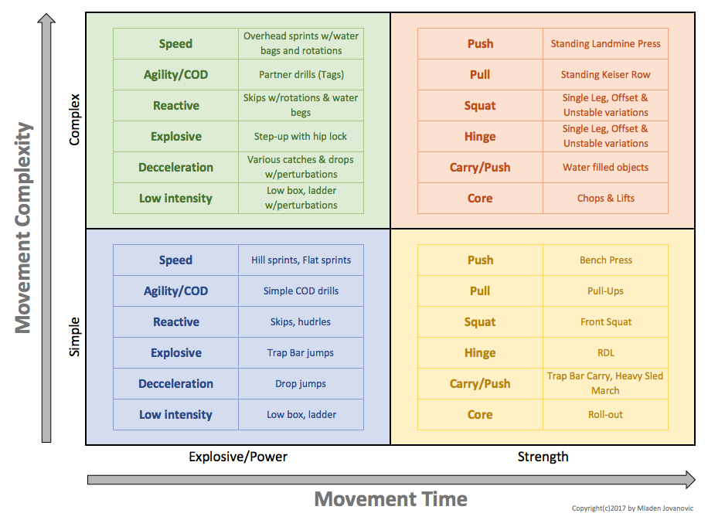

Slide 6
From: Frans Bosch- Strength Training and Coordination: An Integrative Approach

Slide 7
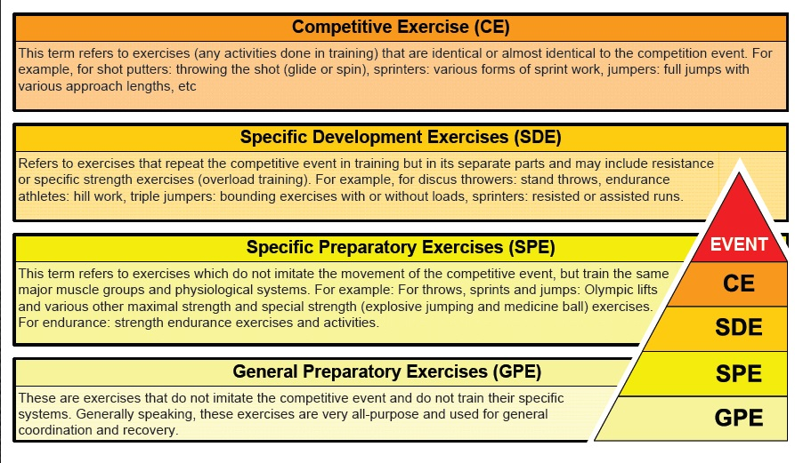

Slide 8
Connection? Specificity of movement

Slide 9
We want exercises that are specific, helpful, and efficient!
The focus could be on:
Specific muscular activity (eccentric, static - isometric, concentric)
Biomechanical correct movements
Power output
Improved balance
Differential learning (body awareness & motivation!)

Slide 10
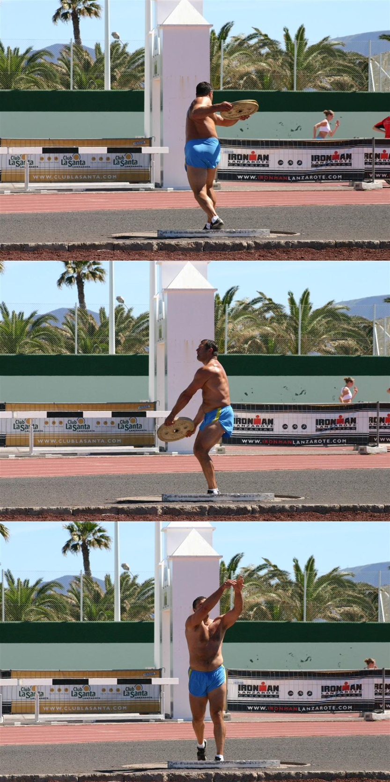
Differential learning:
Variation can also come in different forms such as changing the environment, changing the task, or changing the organism. For example changing the organism by pre-fatiguing an athlete can help develop technique that will be stronger under pressure.
Wolfgang Schöllhorn: differenzieles lernen*

Slide 11
(more) emphasis on:
strength(ening)
speed of the overall movement
power
rythm
balance / propriocepsis
(part of ) the sport-specific movement
flexibility / mobility
plyometrics
torque
etc.
a combination of parameters

Slide 12
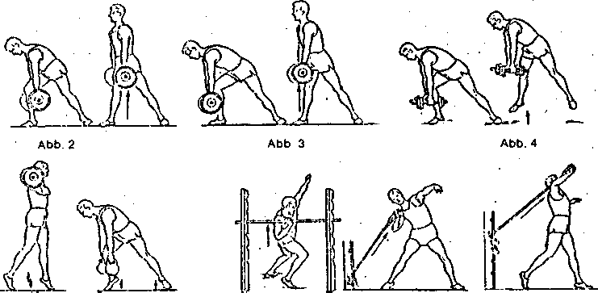
Specific strength improvement:

Slide 13
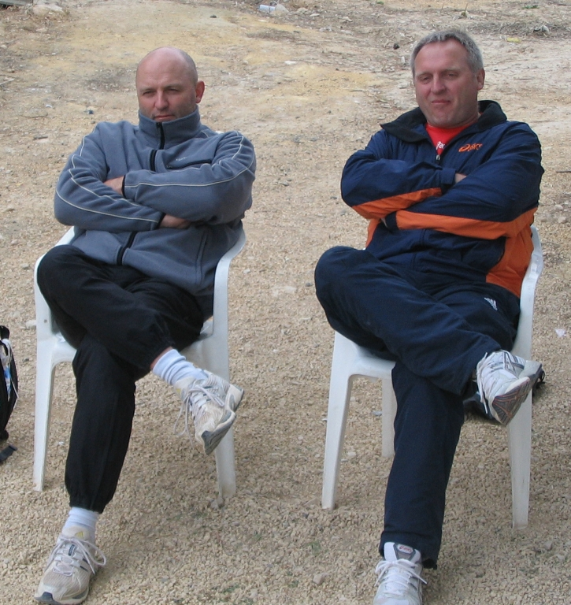
Examples Hammer throw
S & S
Bernhard Riedel (Haber, Rodenau, Weis, Kobs)
Marin Ständner

Slide 14
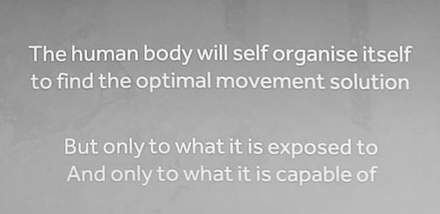
transfer = more centimeters and meters, is wat counts most, of course
(but most of the time you first have to invest before you can harvest
→ adaption takes time!)
It’s good to know the limits of wat is possible (but don’t go to far!)

Slide 15
Discussion…:
We can learn by break things down (part method) or keeping them together (whole method). Where possible, keep things together. As discussed above, the body needs help building those links and does not function well unless each part is connected to the result you want.
Think outside the body – All too often I tell athletes what to do with a muscle or limb, but the body thinks in terms of movements and not muscles. Research has shown that movements can be better controlled when the focus lays outside the body rather than inside it.
Thinking about the intention of the movement rather than the flexion of the muscle helps. This type of thinking is lacking in the weight room. We need to find strength training exercises with a similar intention to the movements we are training for!

Slide 16
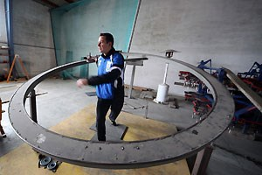
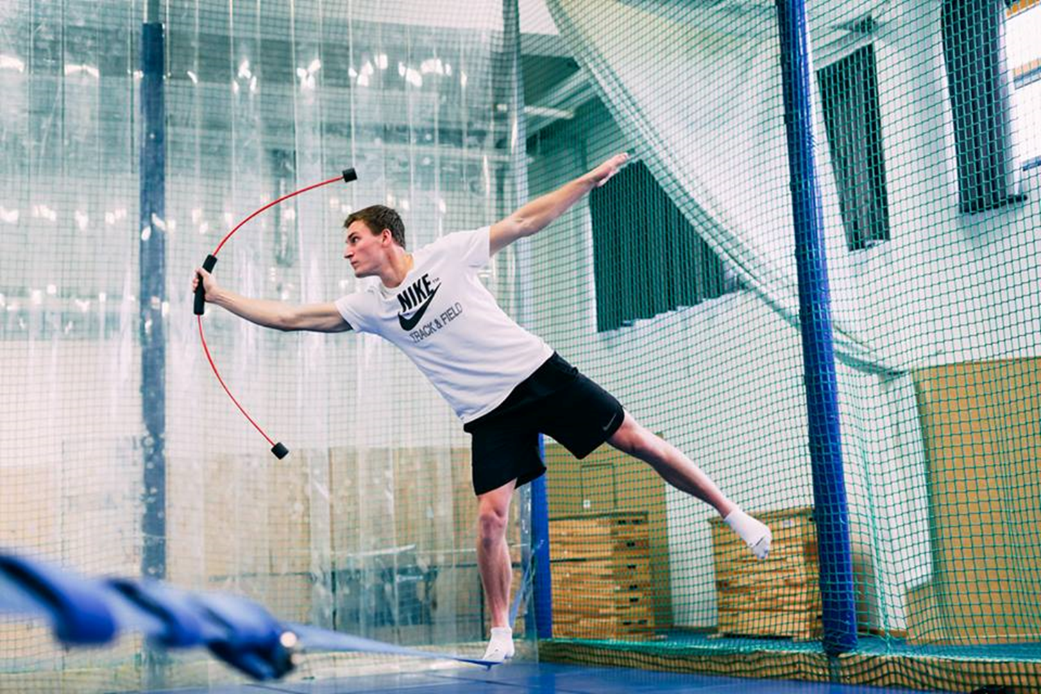
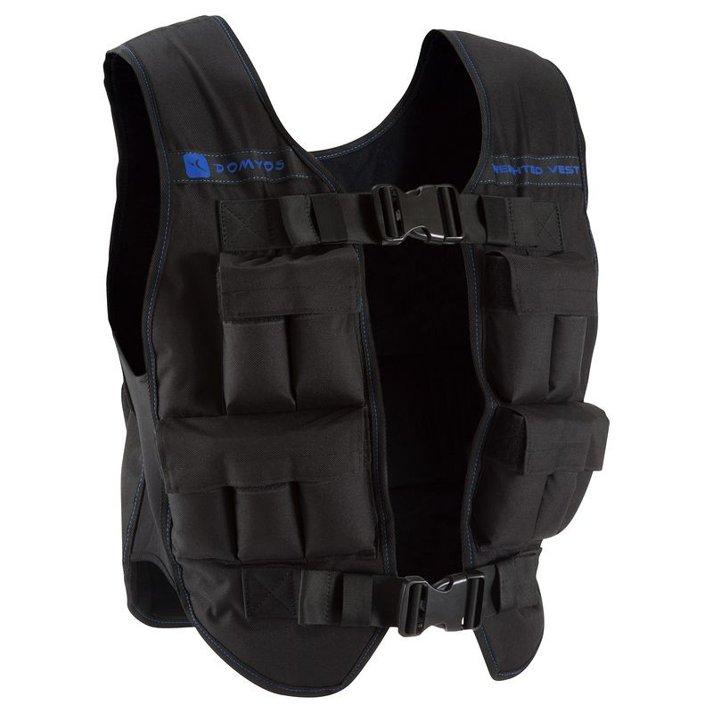
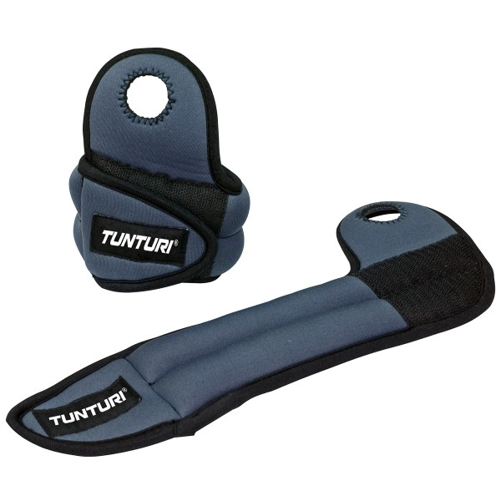
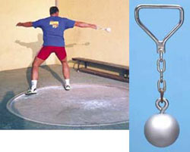

Slide 18
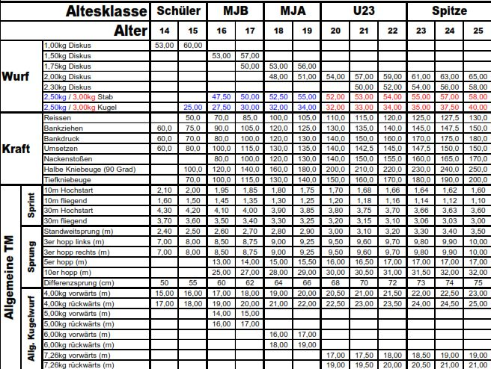
German Zubringer Leistungen Discus men

Slide 19
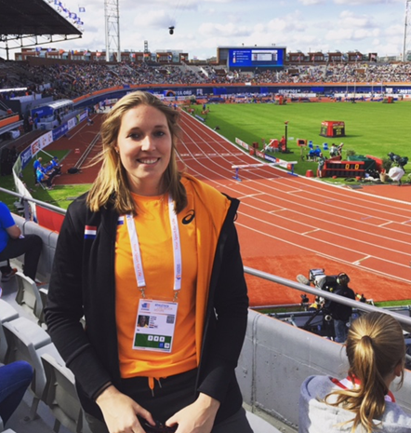
Case study: Corinne Nugter
1992
since 2009 fulltime atlete at
Papendal
quit training shotput in 2013
left handed

Slide 20
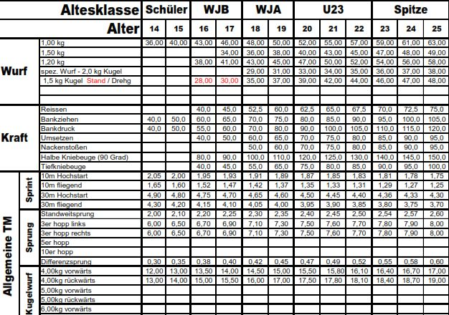
German Zubringer Leistungen Discus women

Slide 21
Personal record development

Slide 22
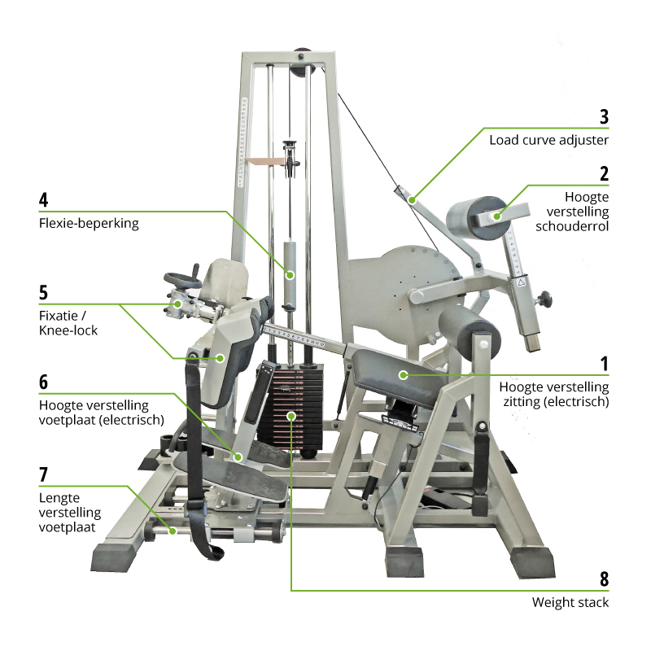

Slide 23
Program examples

Slide 24
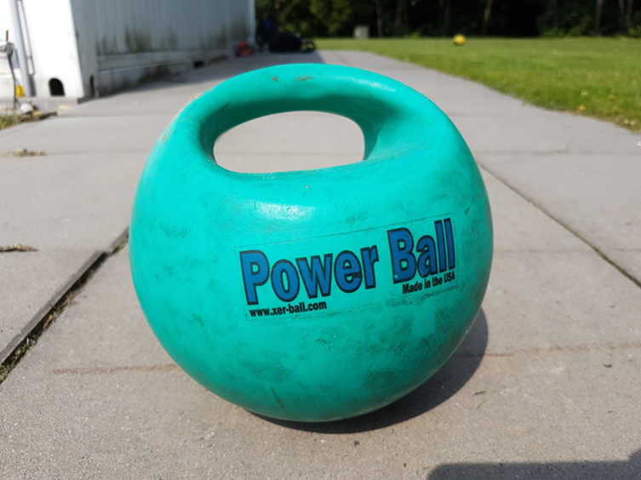
Questions?
© Gert Damkat | 2018

