Slide 1
Talent development of throwers in the Netherlands
recent experiences

Slide 2
A new start in 2014
What was new?
Selection – who did we invite?
Athletes, coaches and parents
Explaining the purpose
Be very clear and honest about the possible selection in the future

Slide 3
The approach
1 weekend with all 12 throwers
5 national training Saturdays with 6 athletes
One final training with all 12 throwers
Some testing
Warming-up – Training – Lunch – Analysis with trainers and athletes – Training
Some program intervention & help

Slide 4
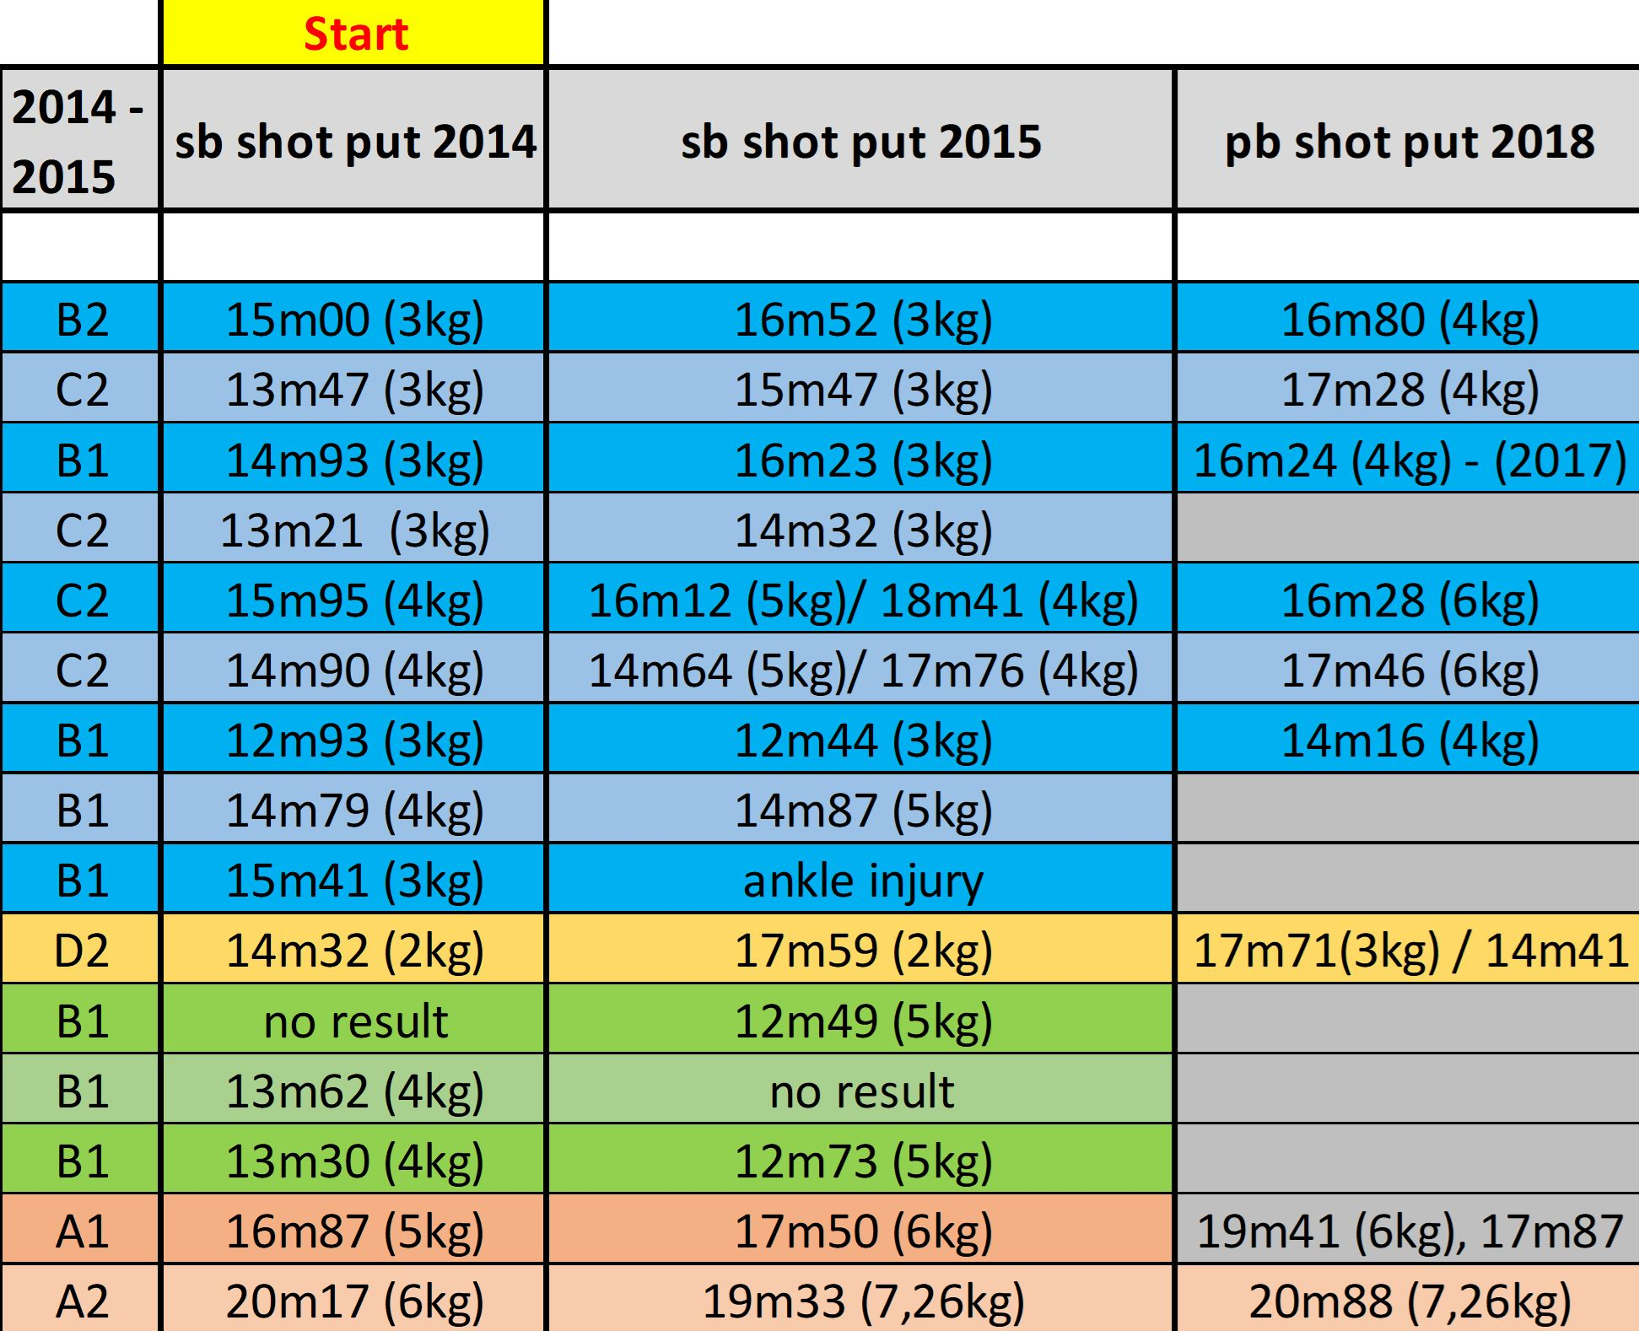

Slide 5
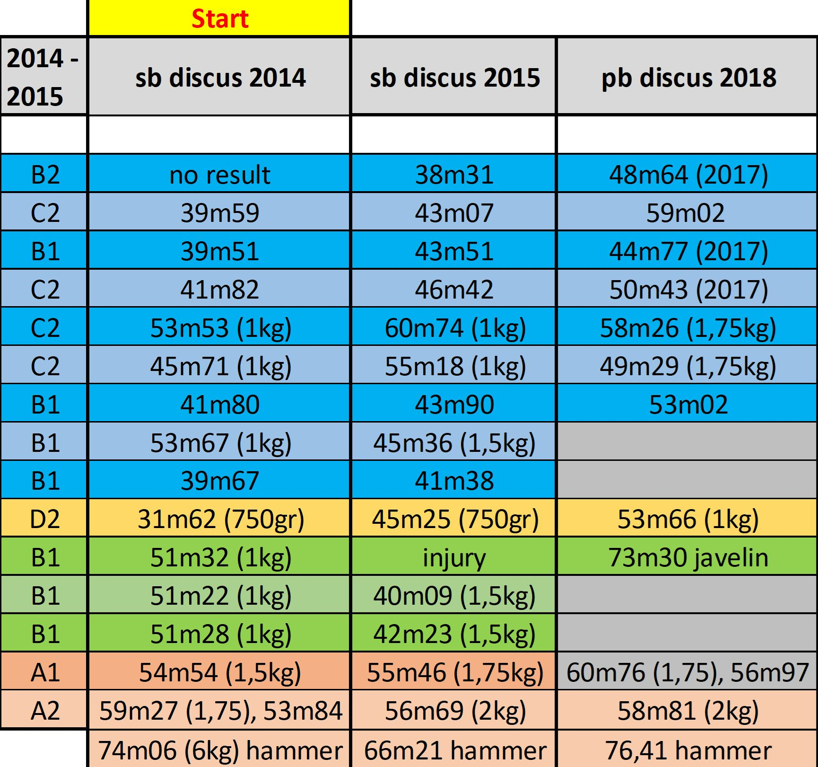

Slide 6
Succes killers
Injury’s
Lack of support (trainer / parents)
Physical limitations
Not enough committment to a program
Mental (and therefore physical) issues – relations, self-image, no group or the wrong group
A combination of these factors

Slide 7
Succes:
Team around the athlete
A few good athletes together – motivation!
A proper build-up: working on ‘work- capacity’!
Also working on limitations
Girls need brakes, boys need competition
Goal-setting!

Slide 10
At Papendal:
Try to create an optimal program for the athlete
Versatile training
From comfort-zone to non-comfort zone and back – create challenges
Multi- directional movements

Slide 11
Training fulltime at Papendal
Dropbox
Fill in the results
Write down your cues
Working on specific needs
Working on overall improvement
Have fun

Slide 12
Program set up & evaluation:
1 on 1 with the athlete – formal and informal
- goal setting
- points to improve
Distances thrown in training
Testing – mostly while throwing and during training camps
- shot put backward and forward
- standing long jump
Distances thrown in competition

Slide 13
Case study: Jorinde van Klinken (2000)
And 56m97 in the hammer

Slide 14
How did she accomplish that?
Strength 2x per week
Hurdles or long jump 1x per week
Running, jumping 1x per week
Throwing 3 – 5x per week
Hammer, shot put & discus!

Slide 15
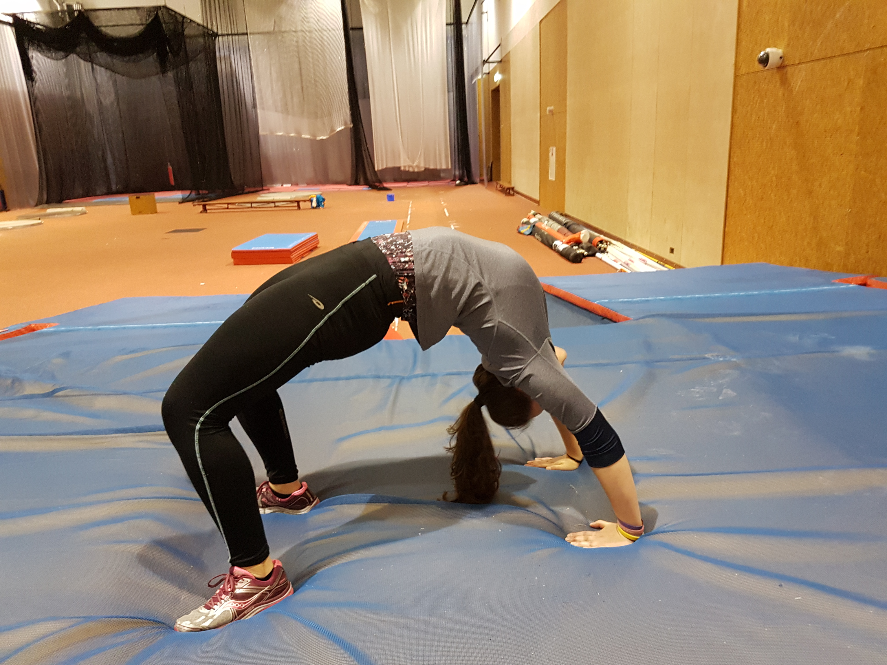
Strengths
Strong legs
Mobility is good
Explosive by nature
Determined
Intelligent

Slide 16
Points to improve on
Finger strength
Upper body strength
Subtle coördination
Technique
Work capacity
Peaking when it counts

Slide 17
Questions?
© Gert Damkat | 2018

