Slide 1
From Multi-Talent to Worldchampion Sprint
Bart Bennema

Slide 2
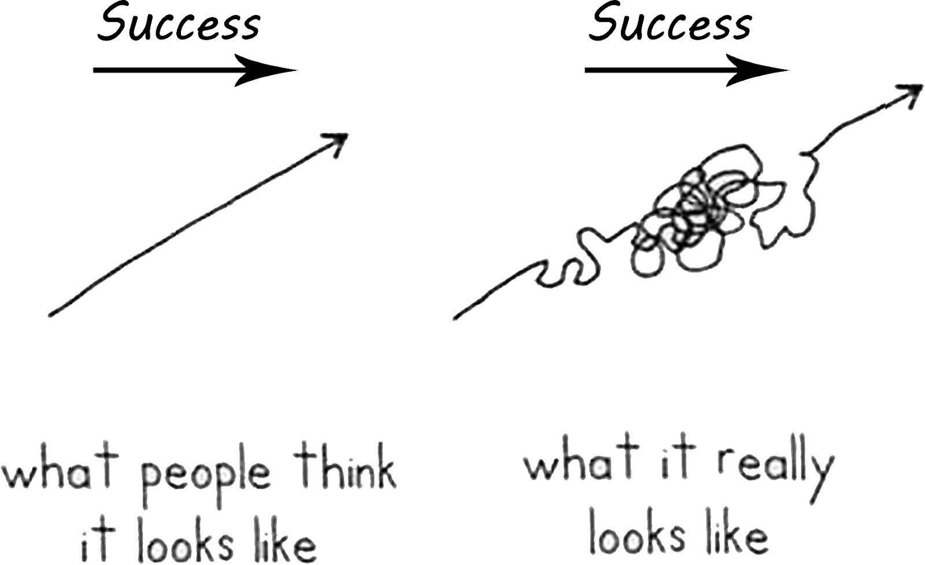

Slide 3
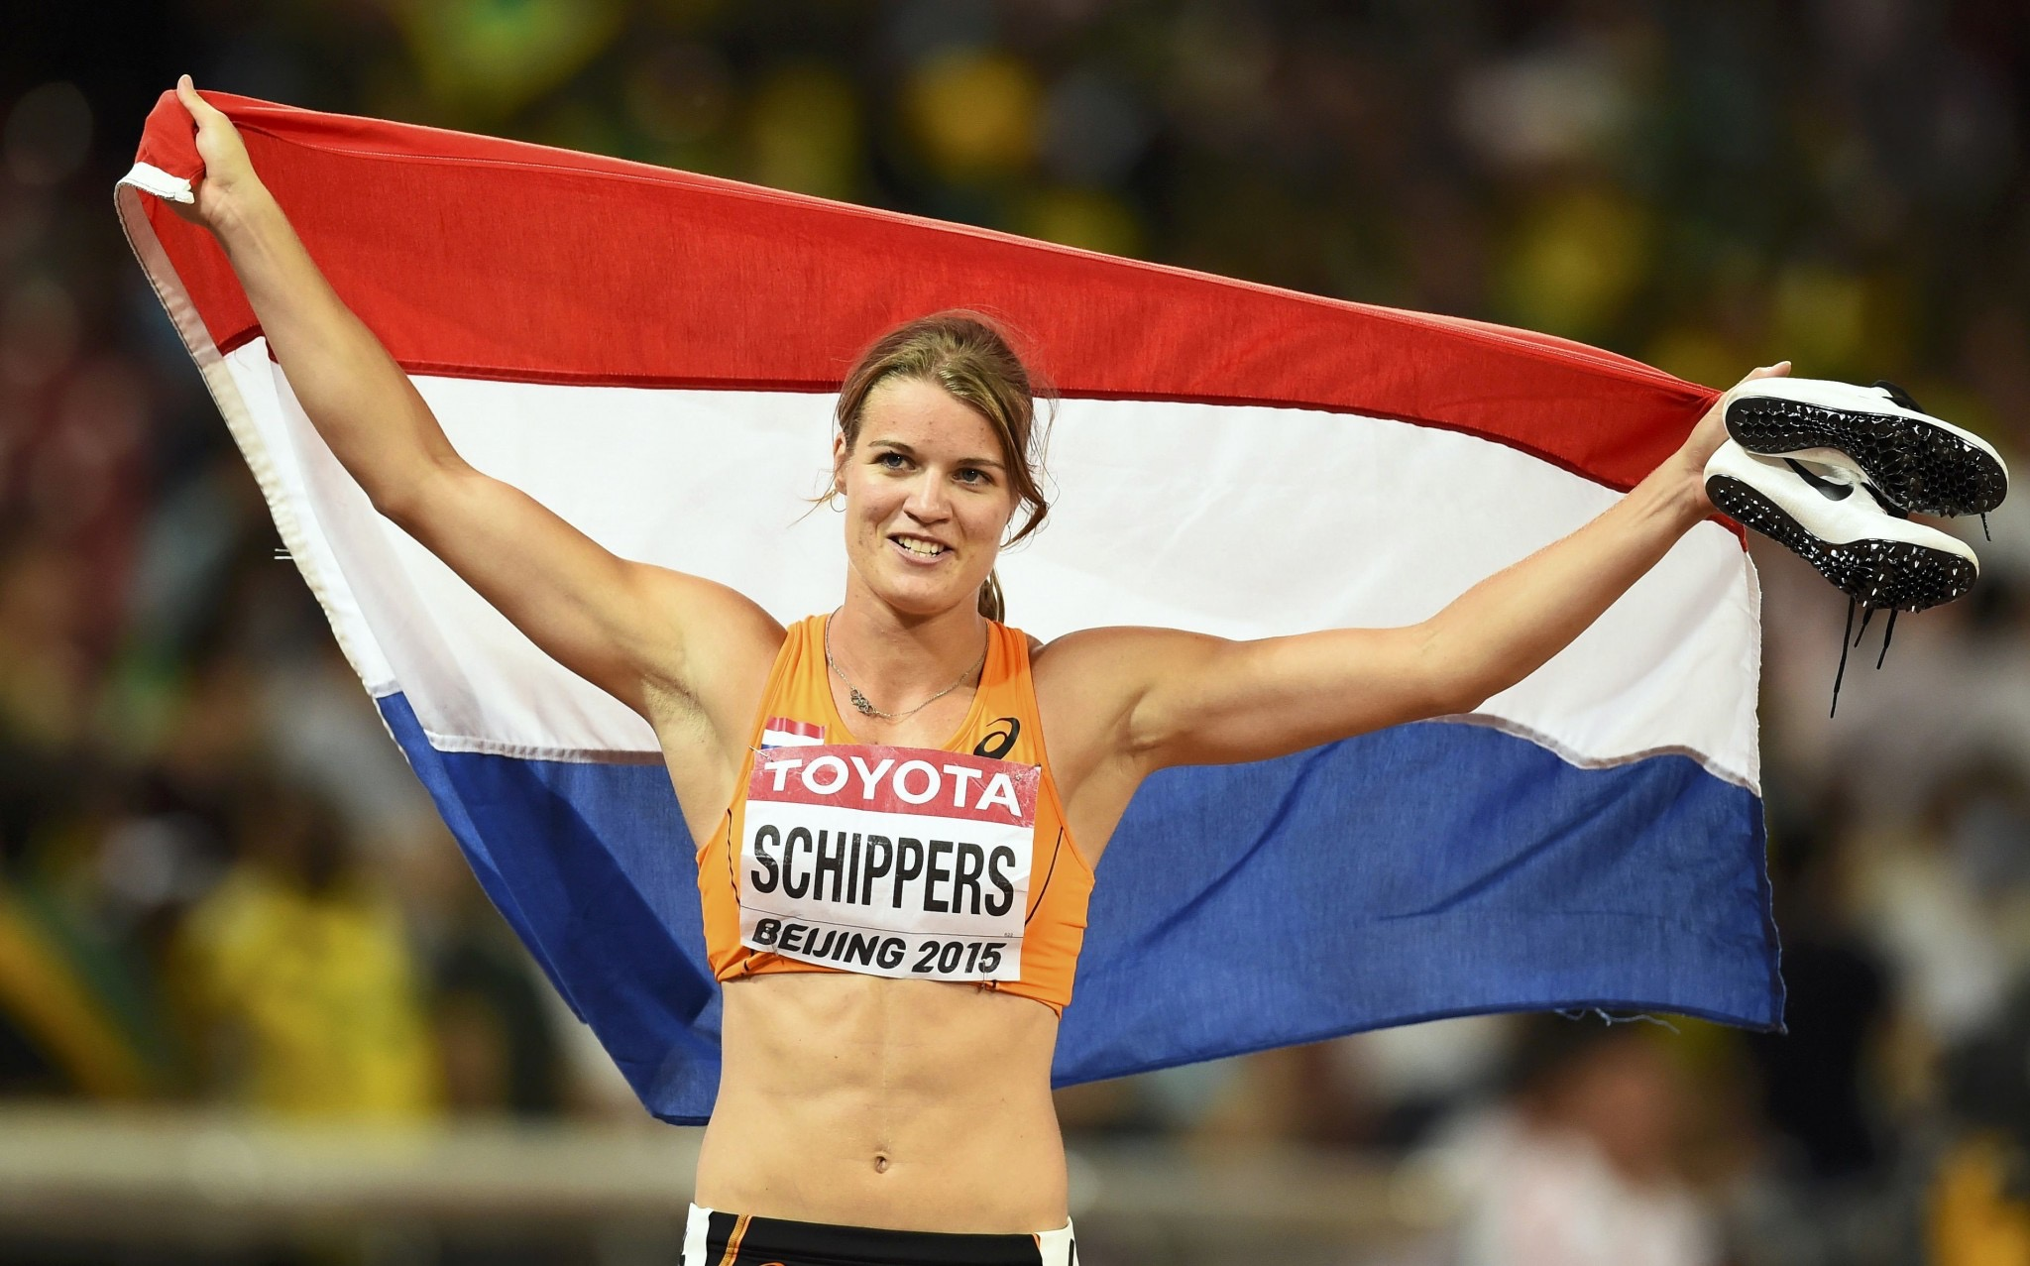

Slide 5
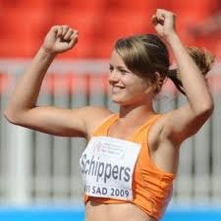
Startingpoint
Dafne 60m
7.60 (15y)

Slide 6
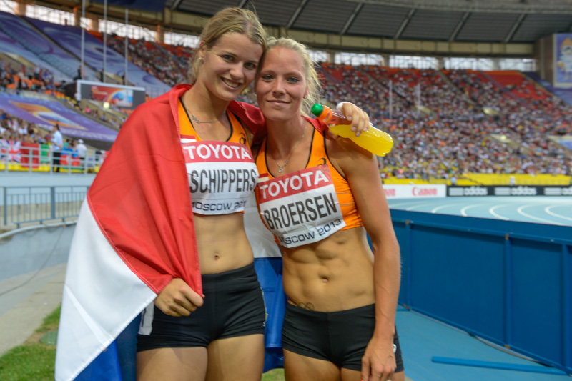
Class of 2009

Slide 7
2009-2010 Focus of (talent) program multi-events
Fulltime coaching and medical support
Work capacity and Fitness, while developing all different techniques
Allround program
Based on SPEED
Based on their strenghts!

Slide 8
Sprint Technique a base for all events
1th year
Frontside mechanics (knee’s/upper leg lead movement)
Run tall (hips under your shoulders)
Feet dorsoflexed
Step over the other knee
2th year
Acceleration mechanics

Slide 9
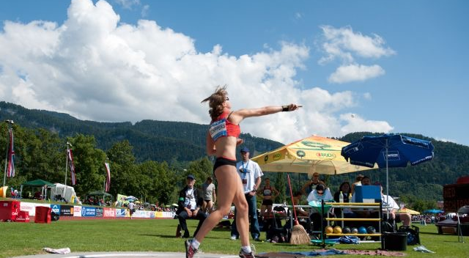
Breakthrough Gotzis 2011
6172points + 22.90sec

Slide 10
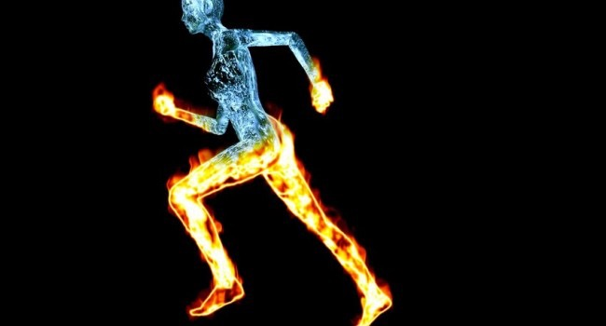
How did we get there (2010-2011)?
Lactic
running sessions
once every 2 weeks

Slide 11
Semi Final WC Daegu 2011 22.92

Slide 12
What went wrong?

Slide 13
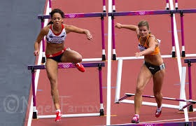
2012, Felt like a disappointment
5th EC 200m
12th OG Heptatlon

Slide 14
September 2012
Which event?……….Heptathlon!
Decided to develop sprints alongside the heptathlon
Indoor sprints, EC23 100m, WC heptathlon

Slide 15
Trainingweek 2013 and 2014
2008-2009 (9-10h) | 2009-2010 (10-11h) | 2010-2011 (12-13h) | 2011-2012 (12-15h) | 2012-2014 (12-18h)
 | Morning 10-12:30h |  | Afternoon 15-17h
Monday | Highjump (Generic Jumps) | Shot | Javelin (Generic Throws) | circuit
Tuesday | Sprint (acceleration+ speed) |  | Weights
Wednesday
Thursday | Hurdles (= acceleration+ speed) | Shot (GT) | Tempo’s 400-200 reps
Friday | (GJ) Longjump | Javelin | Weights
Saturday | General Athletic Development | 8-20x30/30sec runs

Slide 17
Moscow 2013
‘what if I ran the 200m?’
Medal: ‘you see I’m a heptathlete!’ (NR 6477)
But……….11.09 + 22.69 won’t get you into FINALS!

Slide 18
Season 2014
Temporuns: Volume DOWN Intensity UP
Gotzis 6545 and 22.35
DL Lausanne 11.28 (0.302 slip in blocks)

Slide 19
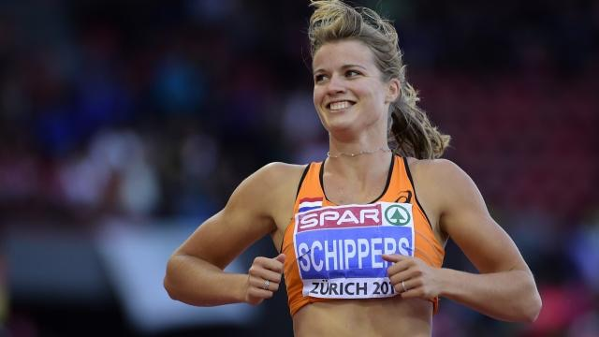
This is the moment to see what’s possible!

Slide 20
Trainingweek 2015
2008-2009 (9-10h) | 2009-2010 (10-11h) | 2010-2011 (12-13h) | 2011-2012 (12-15h) | 2012-2014 (12-18h)
 | Morning 10-12:30h |  | Afternoon 15-17h
Monday | Highjump (Generic Jumps) | Acceleration | Javelin (Generic Throws) | circuit
Tuesday | Sprint (acceleration+ speed) | Shot | Weights
Wednesday
Thursday | Hurdles+ acceleration | Shot (GT) | Tempo’s 400-200 reps
Friday | (GJ) Longjump | Javelin | Weights
Saturday | General Athletic Development | 8-20x30/30sec runs

Slide 21
Plan 2015
PP1 | PP2 | PP3 | CP
0ct-Dec | Jan-March (indoor) | March-May | May(Gotzis)- Aug(WC)
First 3 weeks general work | Indoor is specific training | Similar to PP1+PP2 but shorter and higher level | Keep the motor running
3-4 week cycles | 3-4 week cycles | 3-4 week cycles | 1-3 week cycle
Conditioning Technical new stuff Speedwork | Speedwork Technical allround | Special endurence Technical specific Comp. preparation | Keep doing the basics
3 weeks South Africa | 2 weeks Tenerife | 5-6 weeks Florida

Slide 22
April 10.90 (+3.9) 22.61
May 10.93 (+1.8) 22.39 (Gotzis)
June 11.12 (-0.3) 22.45
DL Paris 11.04
DL Laussanne 22.29
DL Monaco 22.09
DL London 10.91
Nationals 11.02

Slide 24
Progression
Dafne | 2008 | 2009 | 2010 | 2011 | 2012 | 2013 | 2014 | 2015
100m | 12.26 | 11.79 | 11.56 | 11.19NjR | 11.32 | 11.09 | 11.03NR | 10.81NR
200m | 24.95 | 24.21 | 23.70 | 22.69NR | 22.70 | 22.84 | 22.03NR | 21.63NR
HEP |  | 5507 | 5967 | 6172NjR | 6360 | 6477NR | 6545NR

